Slide 1
Chapter 11
_{Design, prototyping}
_{and construction}

Slide 2

Overview
  Prototyping and construction
  Conceptual design
  Physical design
  Generating prototypes
  Support for design

Slide 3
Prototyping and construction
What is a prototype?
Why prototype?
Different kinds of prototyping
low fidelity
high fidelity
Compromises in prototyping
vertical
horizontal
Construction

Slide 4
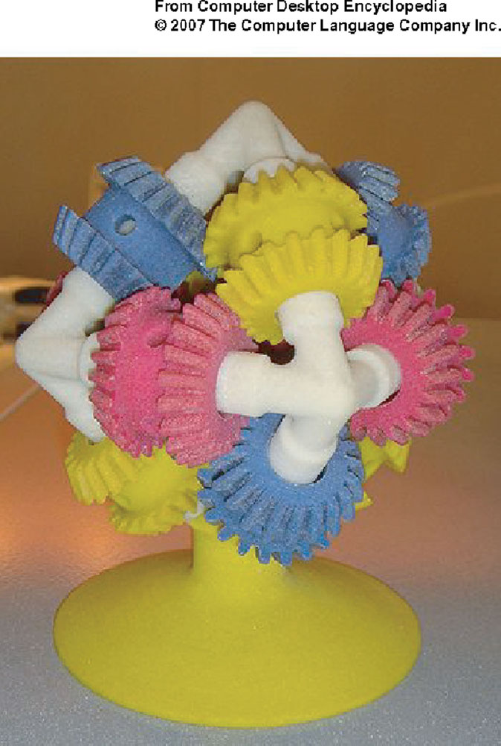
What is a prototype?
In other design fields a prototype is a small-scale model:
  a miniature car
  a miniature building or town
  the example here comes
  from a 3D printer

Slide 5
What is a prototype?
In interaction design it can be (among other things):
  a series of screen sketches
  a storyboard, i.e. a cartoon-like series of scenes
  a Powerpoint slide show
  a video simulating the use of a system
  a lump of wood (e.g. PalmPilot)
  a cardboard mock-up
  a piece of software with limited functionality written in the target language or in another language

Slide 6
Why prototype?
Evaluation and feedback are central to interaction design
Stakeholders can see, hold, interact with a prototype more easily than a document or a drawing
Team members can communicate effectively
You can test out ideas for yourself
It encourages reflection: very important aspect of design
Prototypes answer questions, and support designers in choosing between alternatives

Slide 7
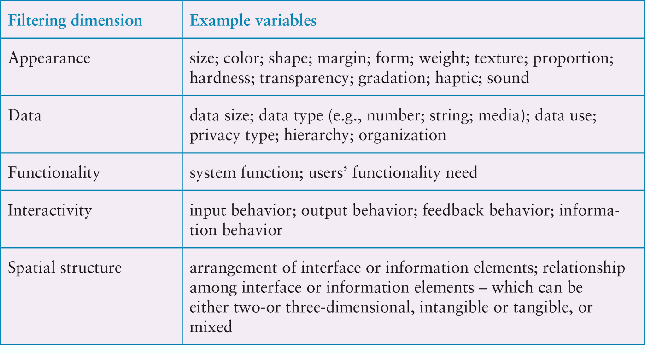
Filtering dimensions of prototyping

Slide 8
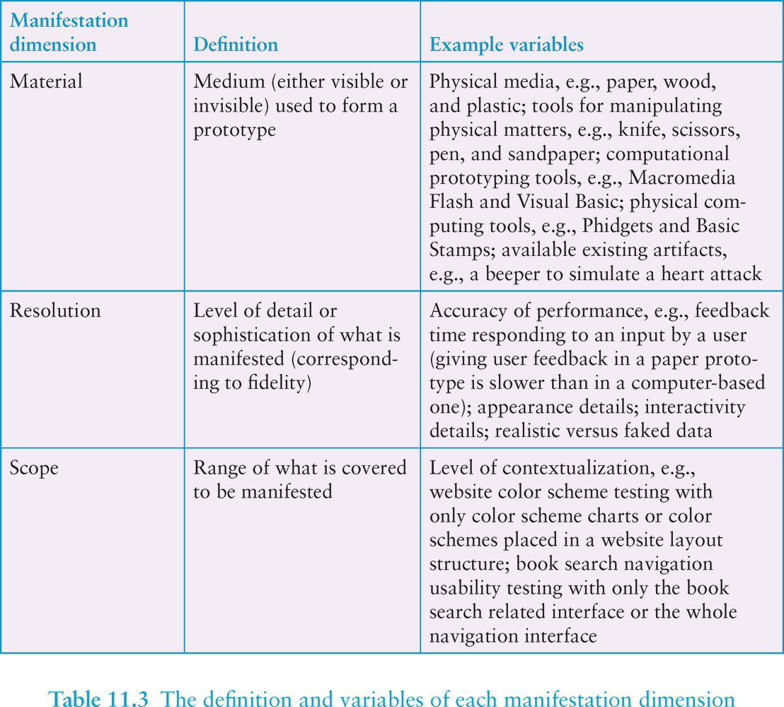
Manifestation dimensions of prototyping

Slide 9
What to prototype?
  Technical issues
  Work flow, task design
  Screen layouts and information display
  Difficult, controversial, critical areas

Slide 10
Low-fidelity Prototyping
Uses a medium which is unlike the final medium, e.g. paper, cardboard
Is quick, cheap and easily changed
Examples:
sketches of screens, task sequences, etc
‘Post-it’ notes
storyboards
‘Wizard-of-Oz’

Slide 11
Storyboards
Often used with scenarios, bringing more detail, and a chance to role play
It is a series of sketches showing how a user might progress through a task using the device
Used early in design

Slide 12
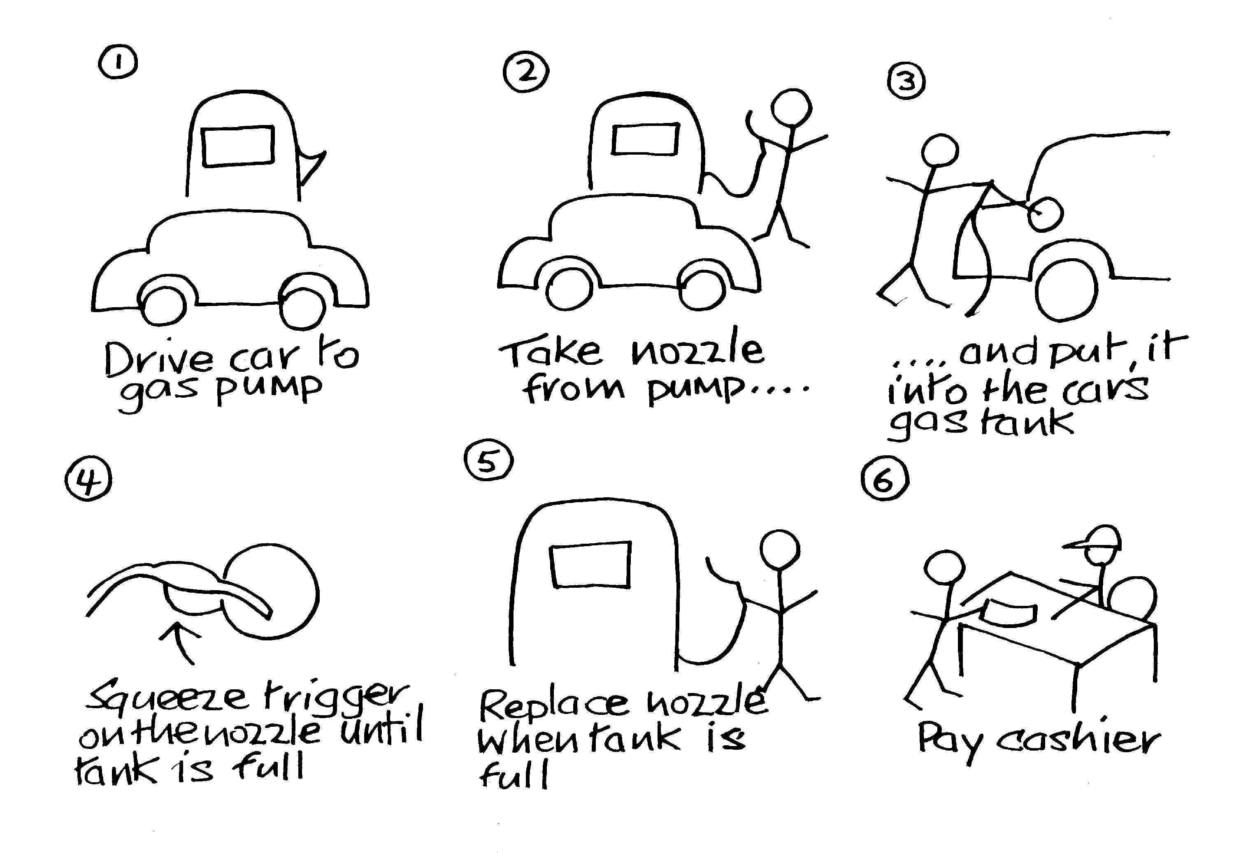
Sketching
Sketching is important to low-fidelity prototyping
Don’t be inhibited about drawing ability. Practice simple symbols

Slide 13
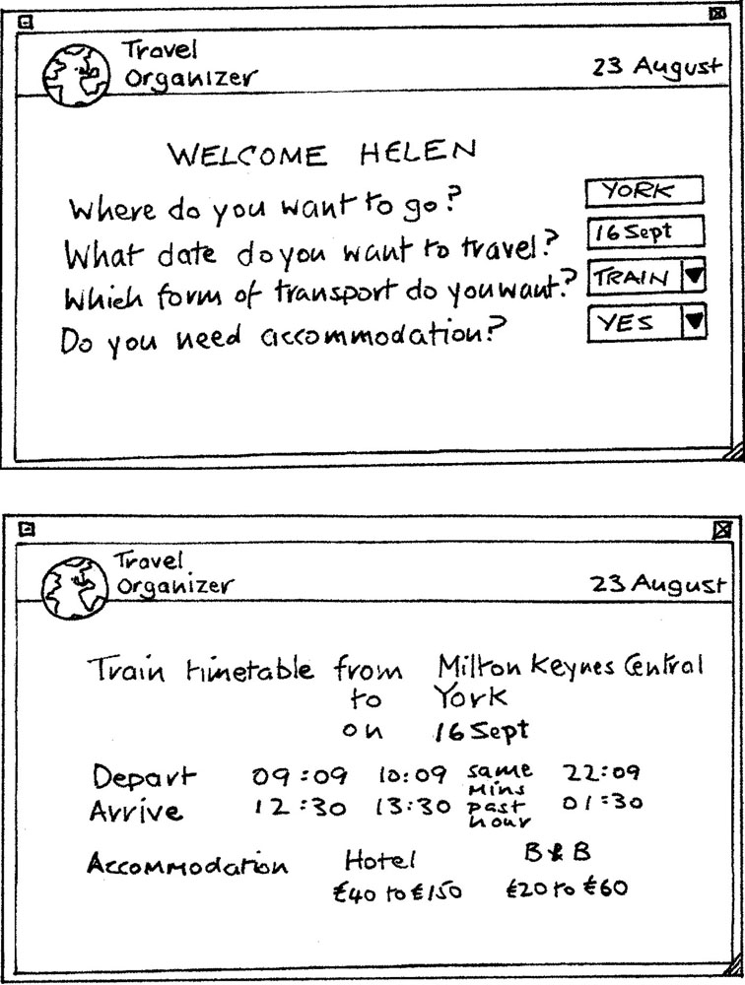
Card-based prototypes
  Index cards (3 X 5 inches)
  Each card represents
  one screen or part of screen
  Often used in website
  development

Slide 14
‘Wizard-of-Oz’ prototyping
The user thinks they are interacting with a computer, but a developer is responding to output rather than the system.
Usually done early in design to understand users’ expectations
What is ‘wrong’ with this approach?
User
>Blurb blurb
>Do this
>Why?

Slide 15
High-fidelity prototyping
  Uses materials that you would expect to be in the final product.
  Prototype looks more like the final system than a low-fidelity version.
  For a high-fidelity software prototype common environments include Macromedia Director, Visual Basic, and Smalltalk.
  Danger that users think they have a full system…….see compromises

Slide 16
Compromises in prototyping
All prototypes involve compromises
For software-based prototyping maybe there is a slow response? sketchy icons? limited functionality?
Two common types of compromise
    ‘horizontal’: provide a wide range of functions, but with little detail
    ‘vertical’: provide a lot of detail for only a few functions
Compromises in prototypes mustn’t be ignored. Product needs engineering

Slide 17
Construction
Taking the prototypes (or learning from them) and creating a whole
Quality must be attended to: usability (of course), reliability, robustness, maintainability, integrity, portability, efficiency, etc
Product must be engineered
    Evolutionary prototyping
    ‘Throw-away’ prototyping

Slide 18
Conceptual design: from requirements to design
Transform user requirements/needs into a conceptual model
“a description of the proposed system in terms of a set of integrated ideas and concepts about what it should do, behave and look like, that will be understandable by the users in the manner intended”
Don’t move to a solution too quickly. Iterate, iterate, iterate
Consider alternatives: prototyping helps

Slide 19
Is there a suitable metaphor?
Interface metaphors combine familiar knowledge with new knowledge in a way that will help the user understand the product.
Three steps: understand functionality, identify potential problem areas, generate metaphors
Evaluate metaphors:
    How much structure does it provide?
    How much is relevant to the problem?
    Is it easy to represent?
    Will the audience understand it?
    How extensible is it?

Slide 20
Considering interaction types
Which interaction type?
    How the user invokes actions
    Instructing, conversing, manipulating or exploring
Do different interface types provide insight?
    WIMP, shareable, augmented reality, etc

Slide 21
Expanding the conceptual model
What functions will the product perform?
    What will the product do and what will the human do (task allocation)?
How are the functions related to each other?
    Sequential or parallel?
    Categorisations, e.g. all actions related to telephone memory storage
What information needs to be available?
    What data is required to perform the task?
    How is this data to be transformed by the system?

Slide 22
Using scenarios in conceptual design
Express proposed or imagined situations
Used throughout design in various ways
  scripts for user evaluation of prototypes
  concrete examples of tasks
  as a means of co-operation across
  professional boundaries
Plus and minus scenarios to explore extreme cases

Slide 23
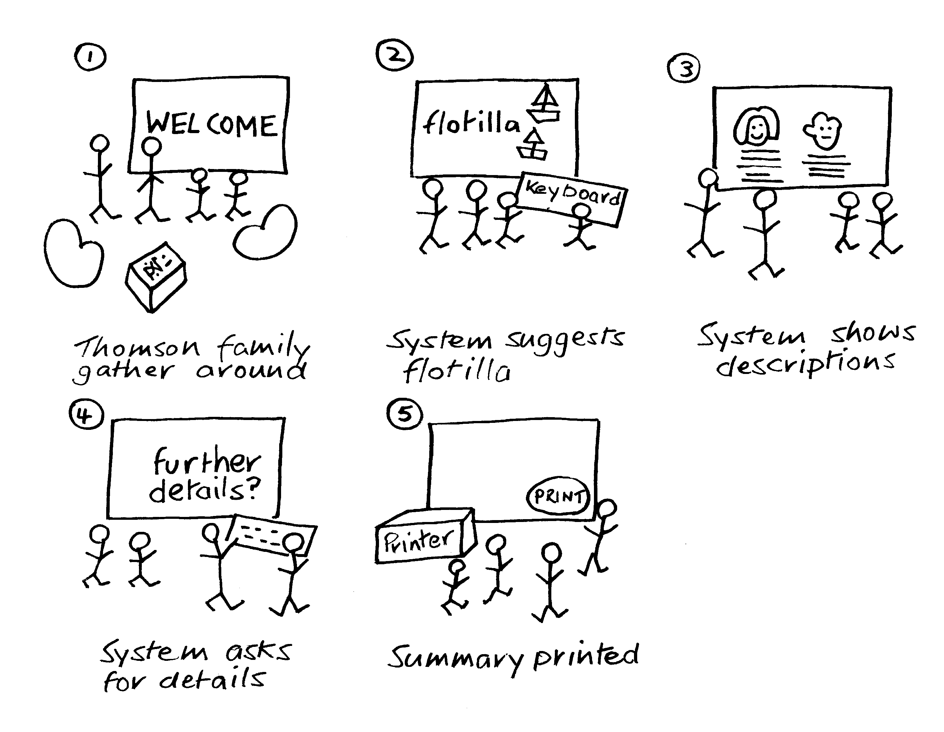
Generate storyboard from scenario

Slide 24
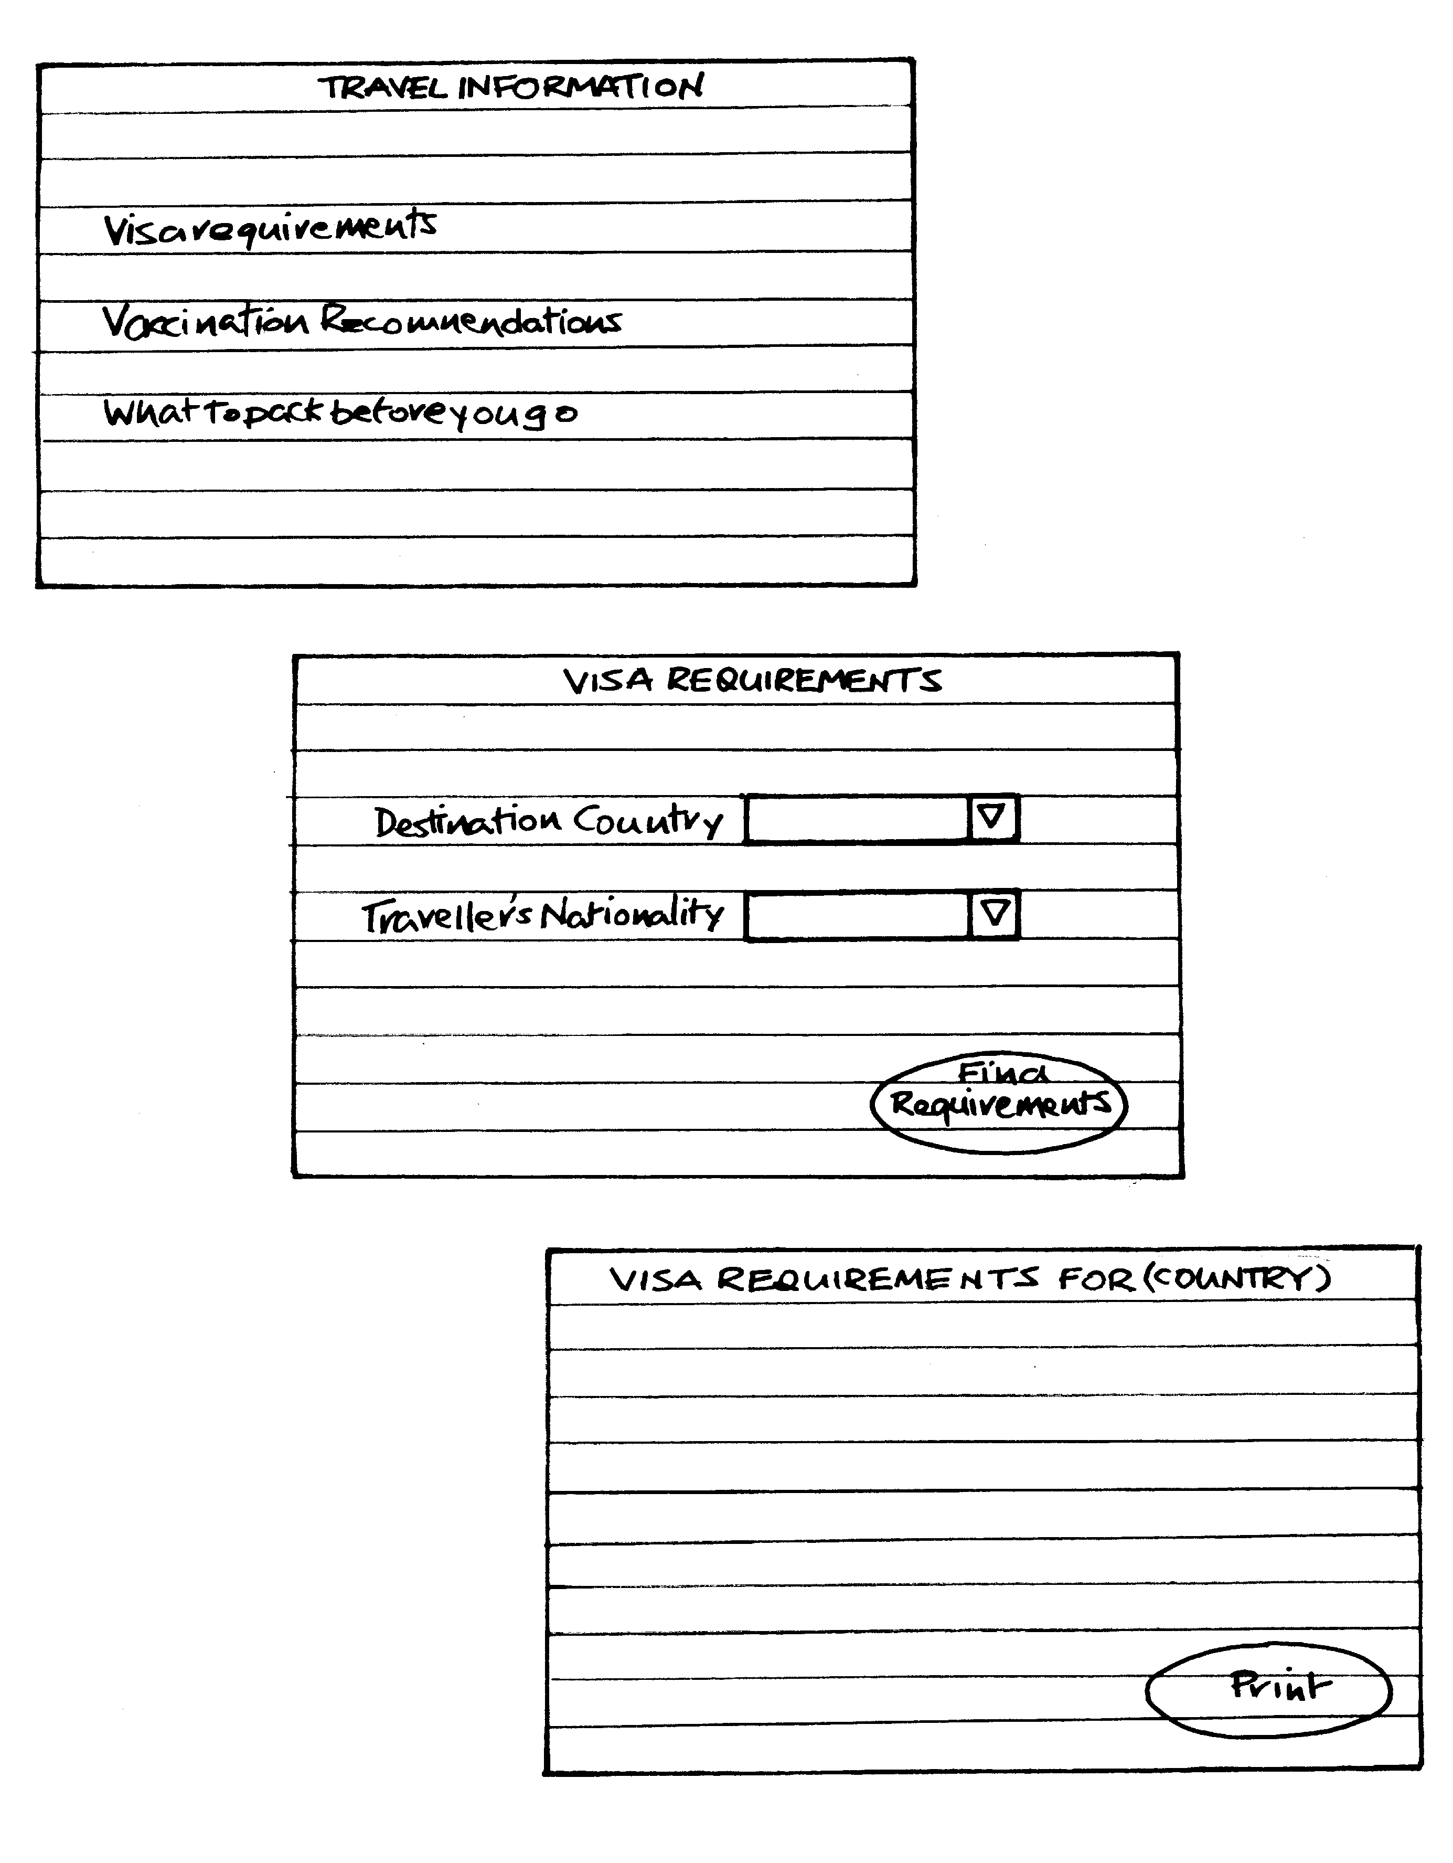
Generate card-based prototype from use case

Slide 25
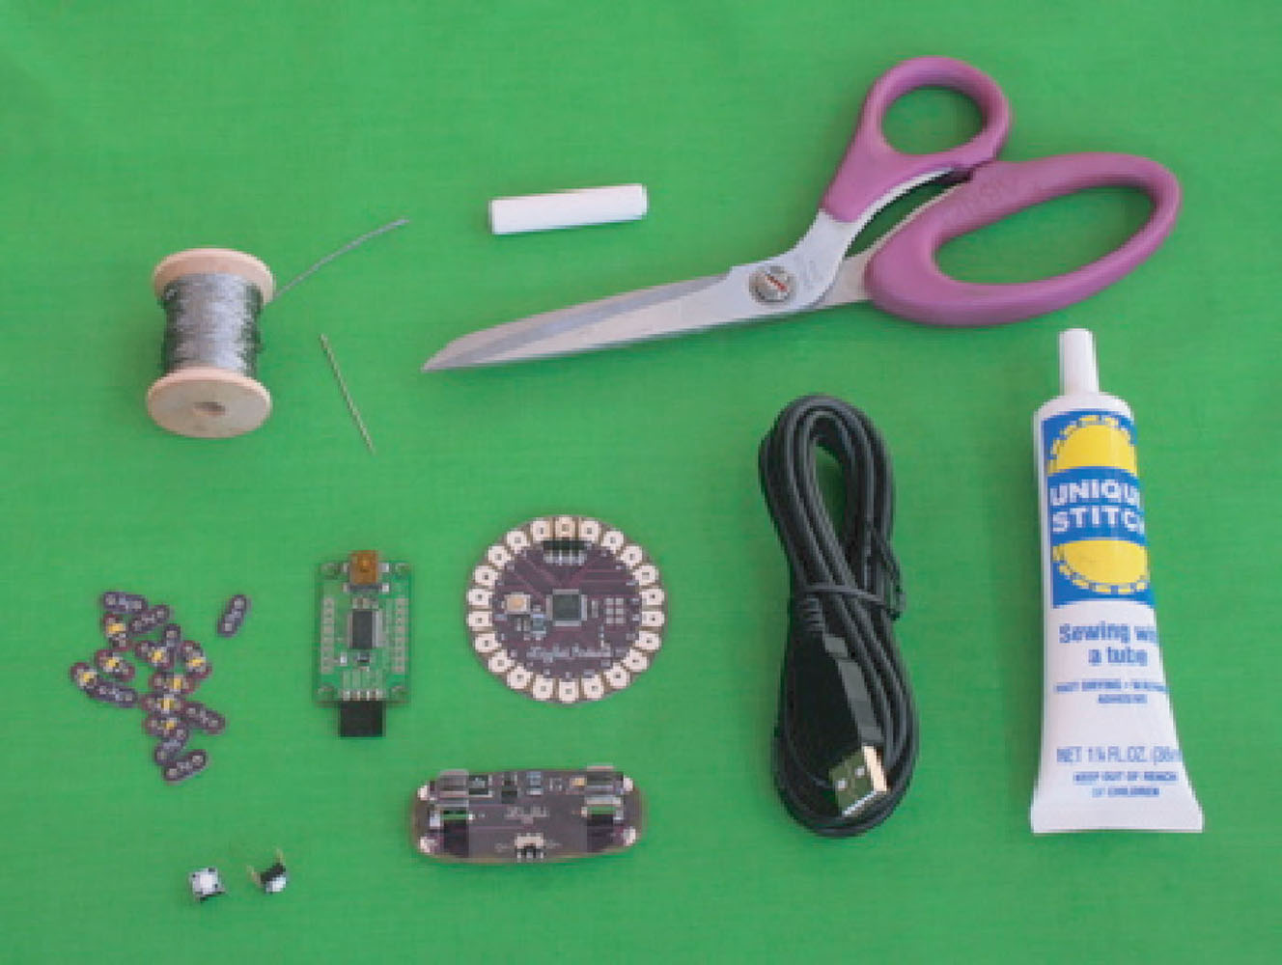
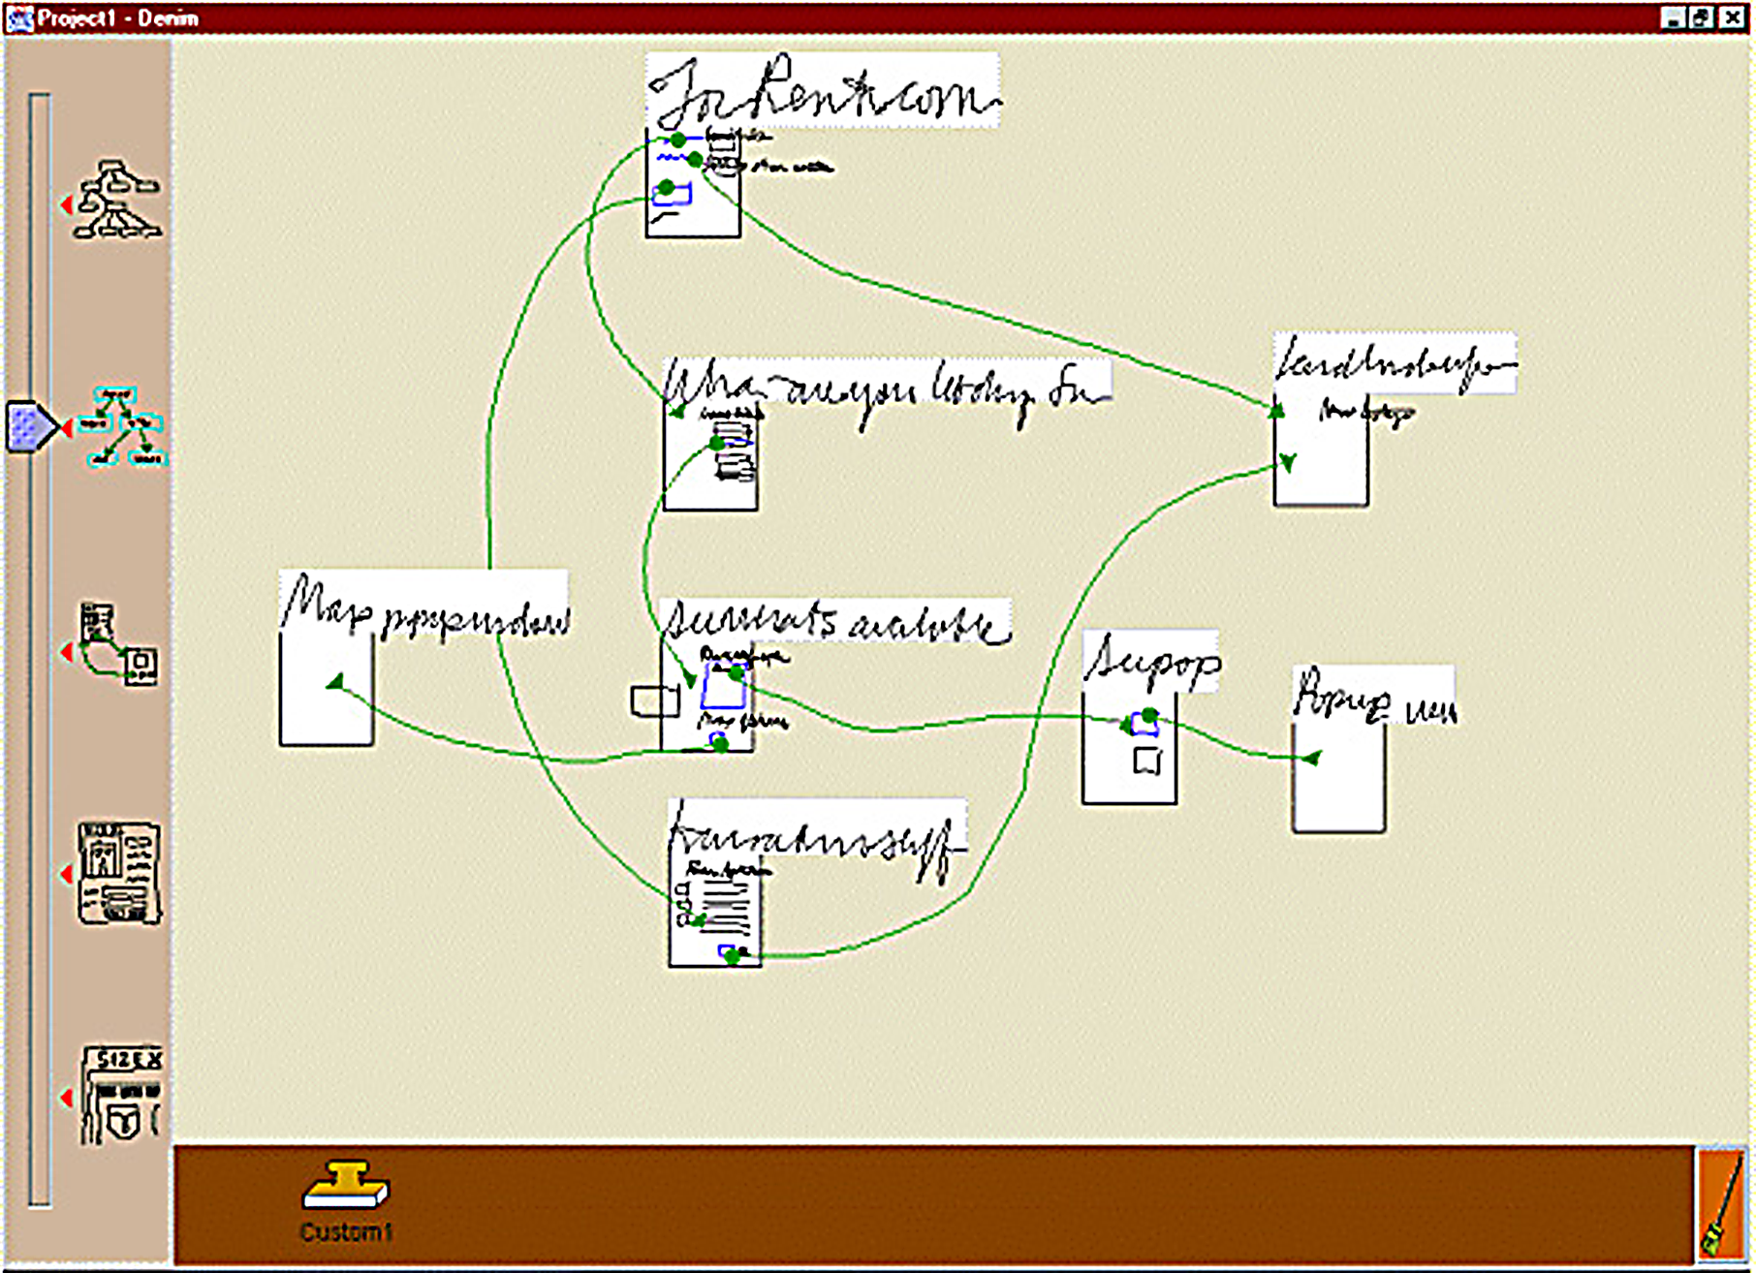
Support for design
Patterns for interaction design
  individual patterns
  pattern languages
  pattern libraries
Open source systems and components
Tools and environments

Slide 26
Summary
Different kinds of prototyping are used for different purposes and at different stages
Prototypes answer questions, so prototype appropriately
Construction: the final product must be engineered appropriately
Conceptual design (the first step of design)
Consider interaction types and interface types to prompt creativity
Storyboards can be generated from scenarios
Card-based prototypes can be generated from use cases

